Slide 1




Sorting Algorithms
Design & Analysis

Slide 2
Sorting Problem
Sorting Problem
Input: A sequence of n numbers(a1,a2,...an)
Output: A permutation (reordering)(a1’,a2’,...an’) of the input sequence such that a1’<=a2’<=...an
Efficiency and Passes
Efficiency denotes how much time the algorithm takes to sort the elements
Efficiency of sorting algorithm is measured in terms of time complexity –big-Oh notations
O(n²), O(nlogn)
Passes -The phases in which elements are moving to acquire their proper position

Slide 3
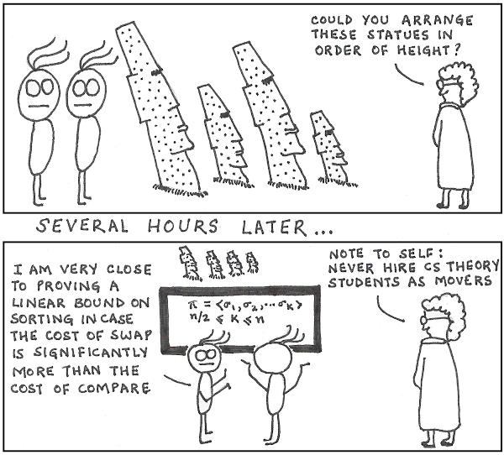
Analysis of:
Sorting Algorithms
Bubble Sort
Selection Sort
Insertion Sort

Slide 4
Bubble Sort
Idea:
Repeatedly pass through the array
Swaps adjacent elements that are out of order
Easier to implement, but slower than Insertion sort
i
1
2
3
n
5
3
1
9
8
2
4
7
j

Slide 5
Example

Slide 6
Bubble Sort
for(i=0;i<n-1;i++)
{
for(j=0;j<n-i-1;j++)
{
if (a[j]>a[j+1])
{
temp=a[j];
a[j]=a[j+1];
a[j+1]=temp;
}
}
}

Slide 7
Selection Sort
Idea:
Find the smallest element in the array
Exchange it with the element in the first position
Find the second smallest element and exchange it with the element in the second position
Continue until the array is sorted
Disadvantage:
Running time depends only slightly on the amount of order in the file

Slide 8
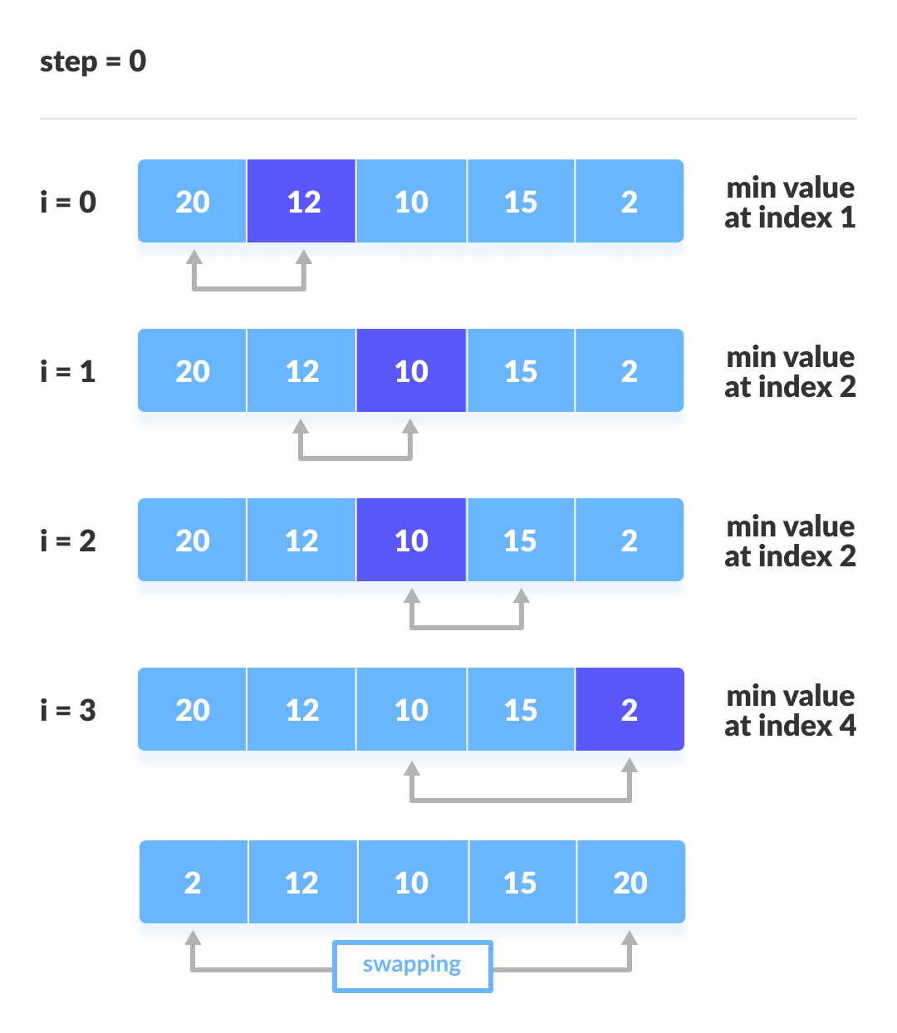
Example

Slide 9
Illustration

Slide 10
Selection Sort
for(i=0;i<n;i++)
{
min=a[i];
pos=i;
for(j=i+1;j<n;j++)
{
if(a[j]<min)
{
min=a[j];
pos=j;
}
}
if (pos!=i)
{
temp=a[i];
a[i]=a[pos];
a[pos]=temp;
}
}

Slide 11
Insertion Sort
Idea: like sorting a hand of playing cards
Start with an empty left hand and the cards facing down on the table.
Remove one card at a time from the table, and insert it into the correct position in the left hand
compare it with each of the cards already in the hand, from right to left
The cards held in the left hand are sorted
these cards were originally the top cards of the pile on the table

Slide 12
Insertion Sort
To insert 12, we need to make room for it by moving first 36 and then 24.
6
10
24
36
12

Slide 13
Insertion Sort
6
10
24
36
12

Slide 14
Insertion Sort
6
10
24
36
12

Slide 15
Insertion Sort
input array
5 2 4 6 1 3
at each iteration, the array is divided in two sub-arrays:
left sub-array
right sub-array
sorted
unsorted

Slide 16
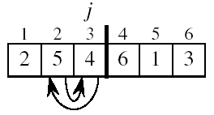
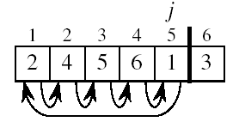
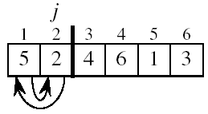
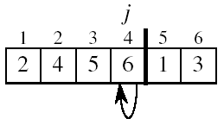
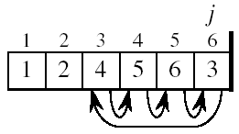
Insertion Sort

Slide 17
INSERTION-SORT
Alg.: INSERTION-SORT(A)
for j ← 2 to n
do key ← A[ j ]
Insert A[ j ] into the sorted sequence A[1 . . j -1]
i ← j - 1
while i > 0 and A[i] > key
do A[i + 1] ← A[i]
i ← i – 1
A[i + 1] ← key
Insertion sort – sorts the elements in place
1
2
3
4
5
6
7
8
a₁
a₂
a₃
a₄
a₅
a₆
a₇
a₈
key

Slide 18
Analysis of Insertion Sort
INSERTION-SORT(A)
for j ← 2 to n
do key ← A[ j ]
Insert A[ j ] into the sorted sequence A[1 . . j -1]
i ← j - 1
while i > 0 and A[i] > key
do A[i + 1] ← A[i]
i ← i – 1
A[i + 1] ← key
Notes:
₇

Slide 19
Best Case Analysis
The array is already sorted
A[i] ≤ key upon the first time the while loop test is run (when i = j -1)
“while i > 0 and A[i] > key”

Slide 20
Worst Case Analysis
The array is in reverse sorted order
Always A[i] > key in while loop test
Have to compare key with all elements to the left of the j-th position ⇒ compare with j-1 elements
“while i > 0 and A[i] > key”

Slide 21
Insertion Sort - Summary
Advantages
Good running time for “almost sorted” arrays Θ(n)
Disadvantages
Θ(n²) running time in worst and average case

Slide 22


